Slide 1


Alexandria University
SYSTEM
LIBRARY
READ TO WIN

Slide 2


SYSTEM PHASES
01
ABOUT SYSTEM
02
DFD_DIAGRAM
03
ERD_DIAGRAM
04
SCHEMAS
05
SQL
06
INTERFACE
07
OUR TEAM

Slide 3
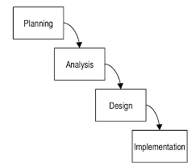



ABOUT SYSTEM
Our system aim to be a real database manage system which allow user to interact (sign up/log in) into library webpage, library have departments...Each has his own books, every book allowed to be borrowed if found , in addition membership and reading rooms for visitors .
reason choosing system :
n today's digital age , managing vast amounts of information efficiently and accurately manually is challenging . A well-designed library management system plays a essential role in providing quality service.

Slide 4


ABOUT SYSTEM OBJETIVES
Objective n° 1
Objective n° 2
Objective n° 3
Applying waterfall development Methodology which identifying system requirements long before programming begins and minimize changes to requirements as project process
Adherence DFD diagramming rules and levels. In addition, ERD to sketch out the design of a database and implement system design into a SQL database considering all tables, attributes, relationships and inserting real data into system
Connecting database to user interface as full webpage that satisfies all system objectives and related to SQL database enabling user to interact with system
create account , borrow books and check if book found or not..., ETC

Slide 5

DFD_DIAGRAM
Represent data flow in system and relationships among data flow evolving from the more general to the more specific level
by the way we have :
Context_level
Level_1
Level_2
shows the system boundaries, external entities that interact with the system, and major information flows between entities and the system.
shows the system's major processes, data flows, and data stores at a high level of abstraction.
shows the sub-processes of one of the processes in the Level-0 DFD.

Slide 6

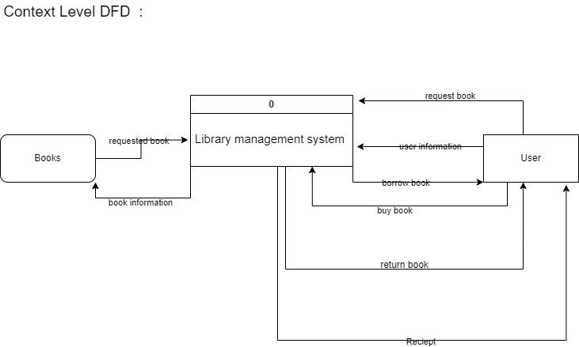
Context_level

Slide 7
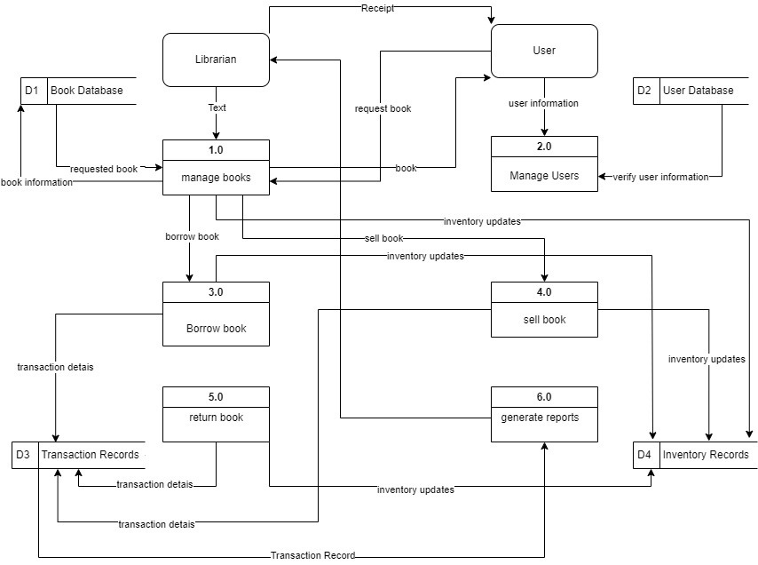
Level_1

Slide 8
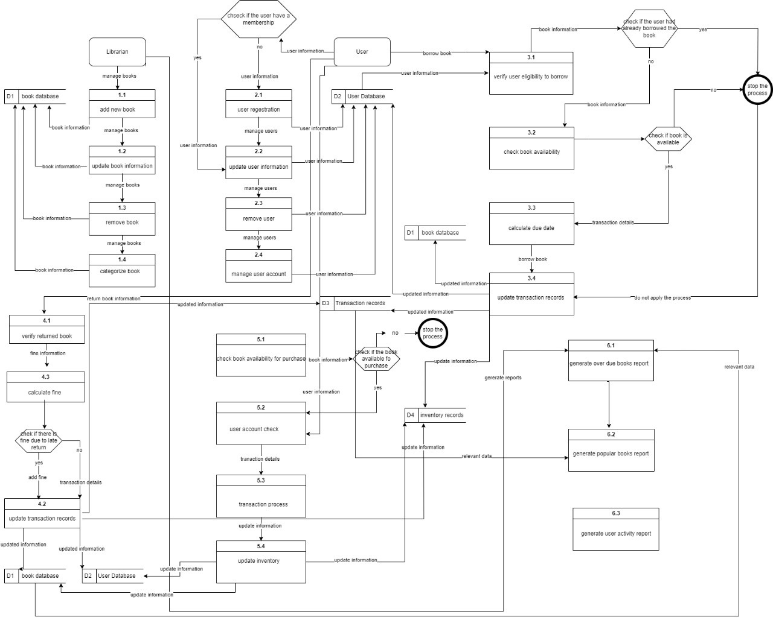
Level_2

Slide 9
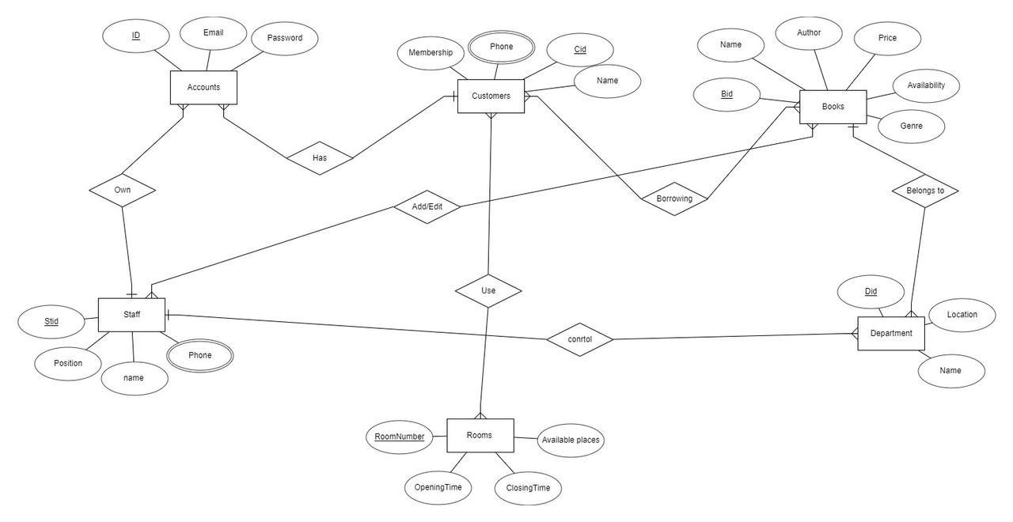
ERD_DIAGRAM
ERD would contain some flow charts referring to entities with attributes and describe relations between them
by the way we have :

Slide 10
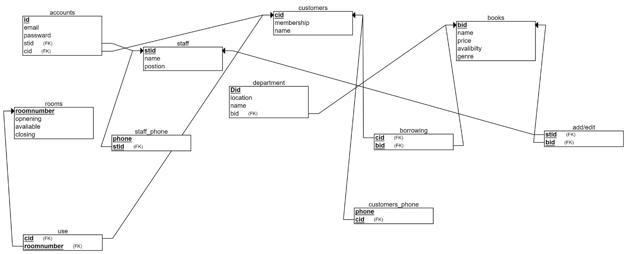
LOGICAL SCHEMA
The logical schema defines the structure of the data itself and the relationships between the various attributes, tables, and entries
by the way we have :

Slide 11
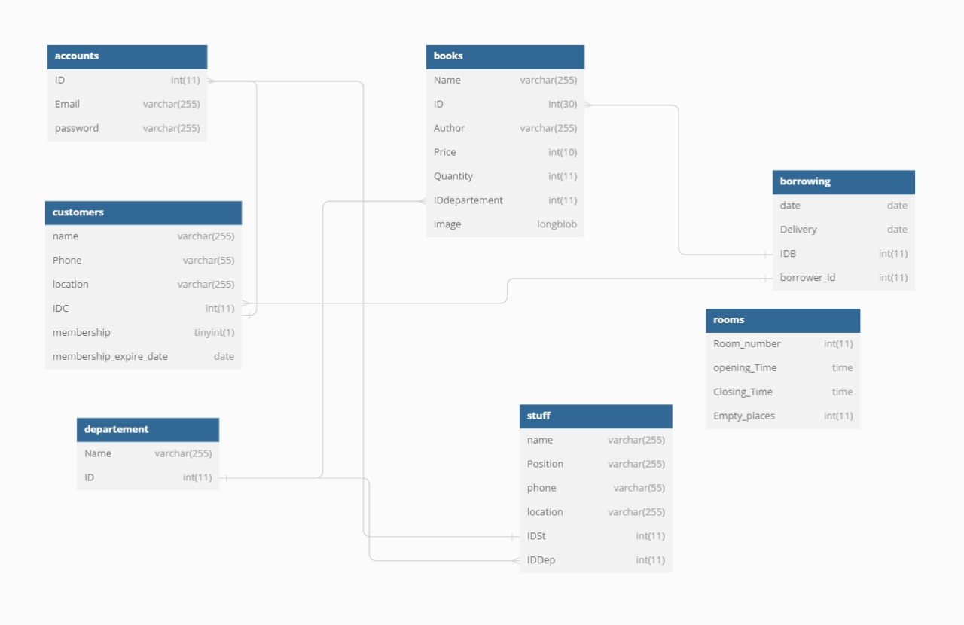
PHYSICAL SCHEMA
The physical schema is a little different and is largely dependent on the structure of the logical schema . It "defines how the data is stored and managed on the physical hard disk of the devices the database is running on.
by the way we have :

Slide 12
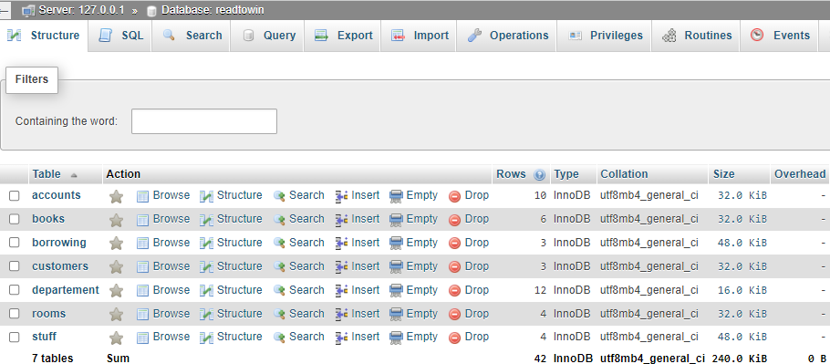
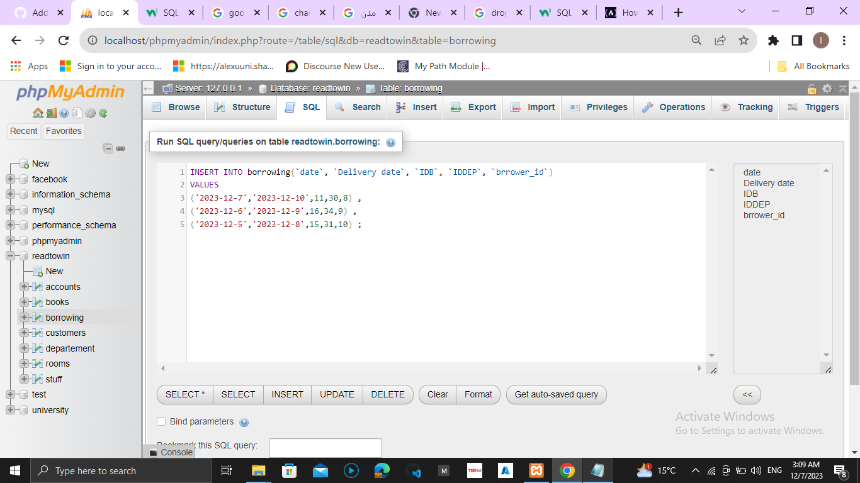
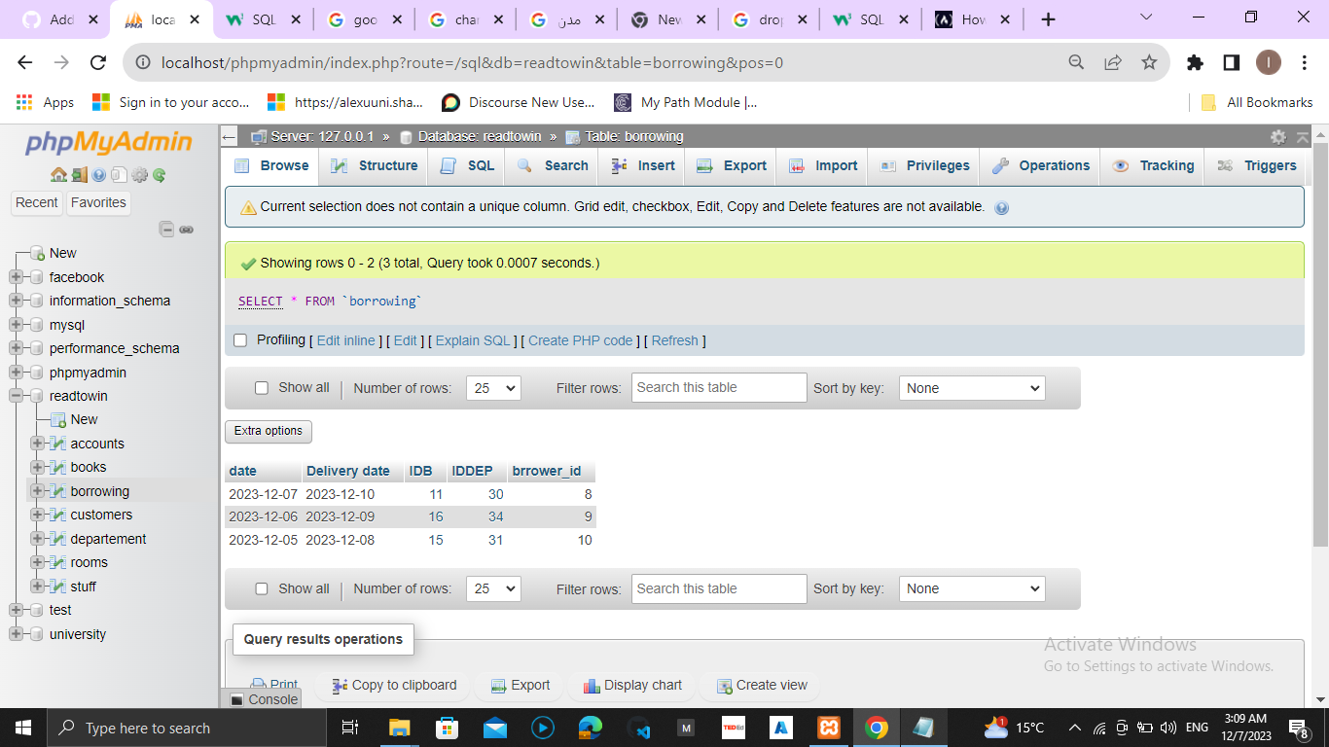
SQL DATABASE
Creation
create table books , accounts(for customers or stuff members), table membership , borrowing and department
Insertion
insert some data to each table considering in mind not to repeat primary keys for spacefic table

Slide 13
INTERFACE
Using(HTML, CSS, PHP and JavaScript)
Our Web Development staff create a real library webpage which enable :
user : to sign up , log in , make a purchase from any department , have membership to borrow books and reserve reading rooms if available
staff members : to edit , add , remove and search for book

Slide 14

INTERFACE
user log in and sign up

Slide 15

INTERFACE
user can navigates departments, show book, it’s price, number of pieces in stock and borrow if available

Slide 16
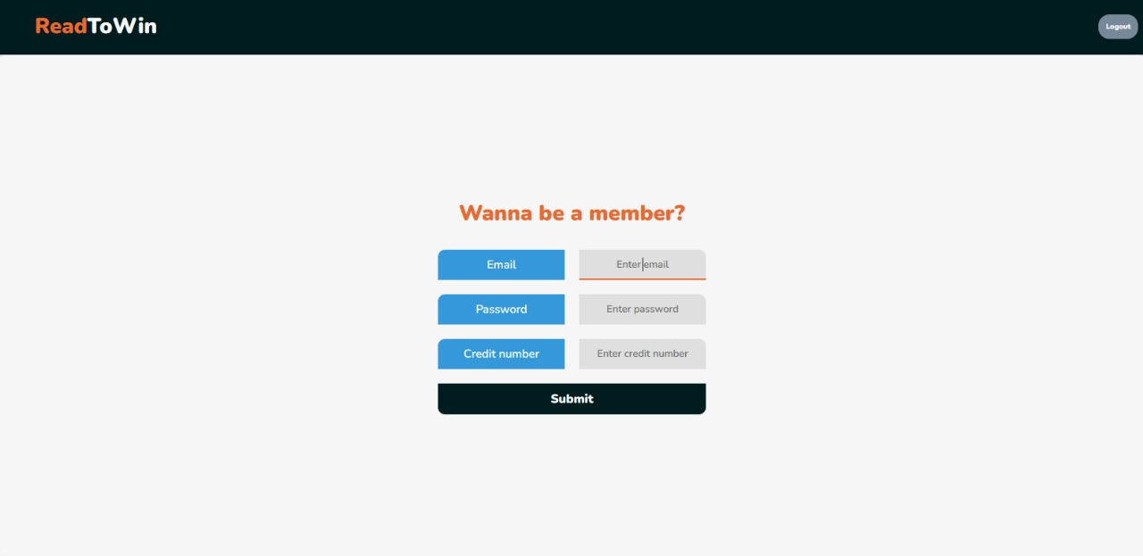
INTERFACE
user should have a membership to borrow books

Slide 17
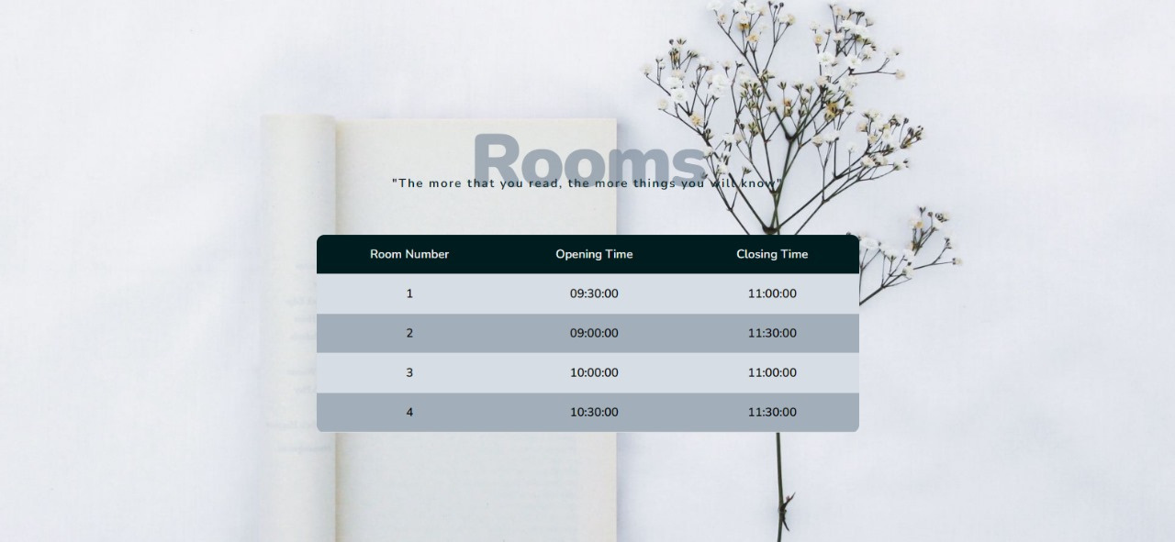
INTERFACE
user can pick a reading room in it’s available time

Slide 18
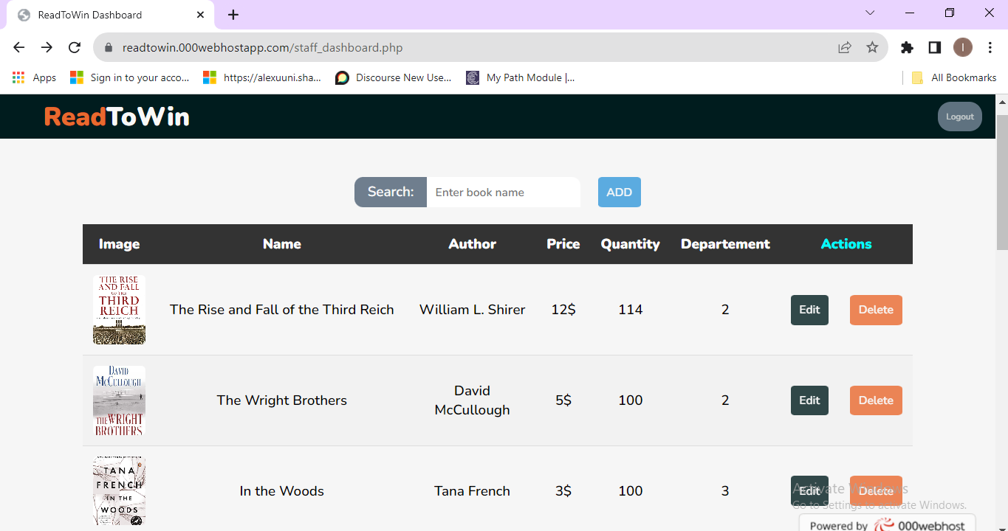
log in for staff member
Staff members can add , delete , edit books

Slide 19
OUR TEAM
Abdalla Osama Gaber
20221460119
Mohamed Ali Mohamed
20221459892
Ahlam Mohamed Mostafa
20221461977
Mostafa Mohamed Kamel
20221469440
Abu_Bakr Mohamed Mahmoud
20221458962
Hazem Mohamed Abu_oqel
20201446543
Remy Marsh
Ahmed Salah Abu_El fadal
20191613603
Mazen Ibrahim El_Saed
20201373615
Abd_El Rahman Mohamed Mahmoud
20201497684

Slide 20
THANK'S FOR WATCHING
Hope get your admiration

